Slide 1
INTRODUCTION to ABAP NEW SYNTAXES
Chithra Narayanan

Slide 2
AGENDA
Quick introduction to new syntaxes
Replace your day to day code lines with new syntaxes
Inline declarations
String operations ( concatenation, alignment , date conversion etc. )
CONV , CAST and VALUE operators
REF operator
COND and SWITCH
FOR syntax
REDUCE syntax
Interface changes / method chaining / functional methods with importing, exporting ,changing
NEW operator
FILTER operation in ABAP new syntax
New Internal table functions like line existence ,line index, with empty key
Some useful utility classes

Slide 3
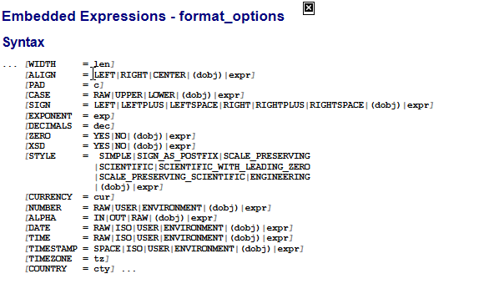

Slide 4
cl_demo_output
https://blogs.sap.com/2016/05/10/cldemooutput-part-1-of-2-usage/
https://blogs.sap.com/2016/05/10/cldemooutput-part-2-of-2-a-look-behind/
ABAP Database Connectivity( ADBC ) classes
cl_sql_statement / cl_sql_connection / cl_sql_exception
http://zevolving.com/2013/05/abap-database-connectivity-adbc/#:~:text=CL_SQL_STATEMENT%20%E2%80%93%20This%20class%20contains%20methods,the%20statement%20on%20other%20DB.
cl_abap_codepage
https://help.sap.com/doc/abapdocu_750_index_htm/7.50/en-US/abencl_abap_codepage.htm

